Slide 1
Housing project in
Durga Bhagawati Rural Municipality,
Badharwa-5,Kailashpur
Rautahat

Slide 2
Introduction
Badharwa is located 6-7 km North- East from Gaur. Bagamati river flows at the eastern side, Jhagh at the north west, Bom canal and Bakaia river at the western side of the Badharwa. Bagmati river flows just 1 Km away from Badharwa.

Slide 3
Findings
In Twenty years, 6 times, Badharwa has been hit by the flood. This year, flood demolished many houses and was the worst of its kind.
All together 15 houses are in need of construction. Two households were missed as they live across the Bom canal.
Many organisations assured them to reconstruct their houses but none of them turned up. They had the same judgement about THRD Alliance in the beginning.

Slide 4
The flood victims seemed to be content with THRD Alliance initative. Mostly, they were happy because we agreed to their request of changing the construction process with the same budget, i.e. Earlier it was decided to keep one 4 mm iron rod in the pillar but we changed it to 3 iron rod of 2.5 mm with rim of 2mm at the interval of 6” inch. This will make pillar stronger.
Relief package reached to these flood victims on time. At present hey have been working to earn their livelihood but they have problem of shelter.
Due to flood there are many big pits all around.
Flood victims will be providing labour cost.

Slide 5
Name of the Householders
Anutha Baitha
Hari chandra Singh
Chandrika Das
Ram Bahadur das
Dinesh Mahara
Ganesh Mahara
Ramesh Mahara
Mahaesh Mahara
Fakir Thakur
Lathu Thakur
Jogindra Thakur
Rajaram das
Indu Ram

Slide 6
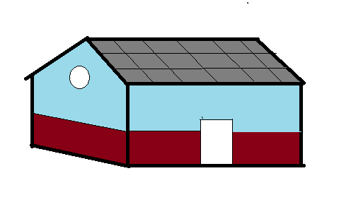
Model of the House
Size of the room – 12*10 ft
Material required
Cement
Iron rod
Bamboo
Concrete tile
Labor

Slide 7
Estimated cost of the Project
Cement - 6 sacks*830*13 house = 64,740
Iron rod - 40*78*13 house = 40,560
Nail, Churia - 13 house = 6500
Small stones- 1 teller = 8500
Sand - 1 teller = 6500
Bamboo - 30*250*13 house = 97,500
Cement tiles- 65*130*13 house =109,850
Labour cost- 3person*700*5 days*13 house =136,500
Total cost= 470,650
* one house estimated cost = 36,203.

Slide 8
Achievements
Materials amount to 45 thousand purchased and delivered to the flood victims.
Field visit increased confidence in the field staff and the flood victims regarding the project.
So far 26 big pillars is completed and small pillars is in the process.
Communication with the suppliers, flood victims and civil societies of Badharwa will help in check and balance of the project.

Slide 9
Target
To complete the project in 15-20 days.

Slide 10
Recommendation
Two households has been left out as they reside across the bom canal.
One of the family is staying in school and the other old man is taking shelter in neighbors home.
If possible we should also construct house for them.
Regular follow up and monitoring is needed from Kathmandu.

Slide 11
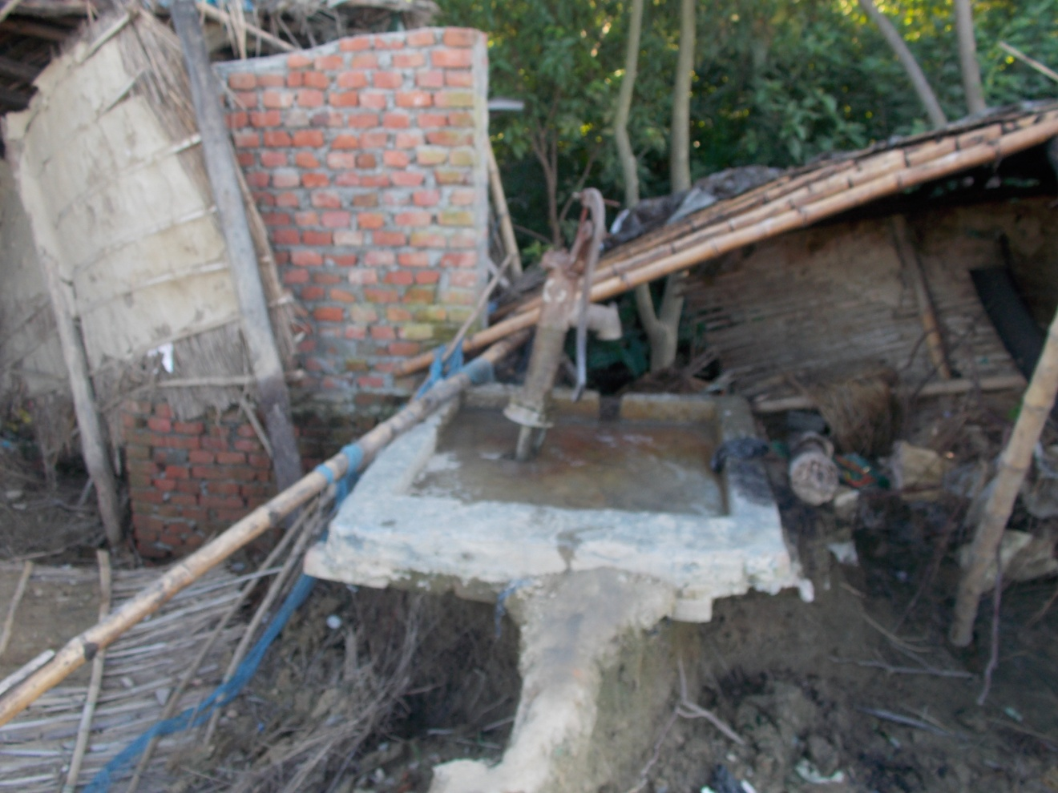
Big pits all around
Hand pipe in the picture

Slide 12
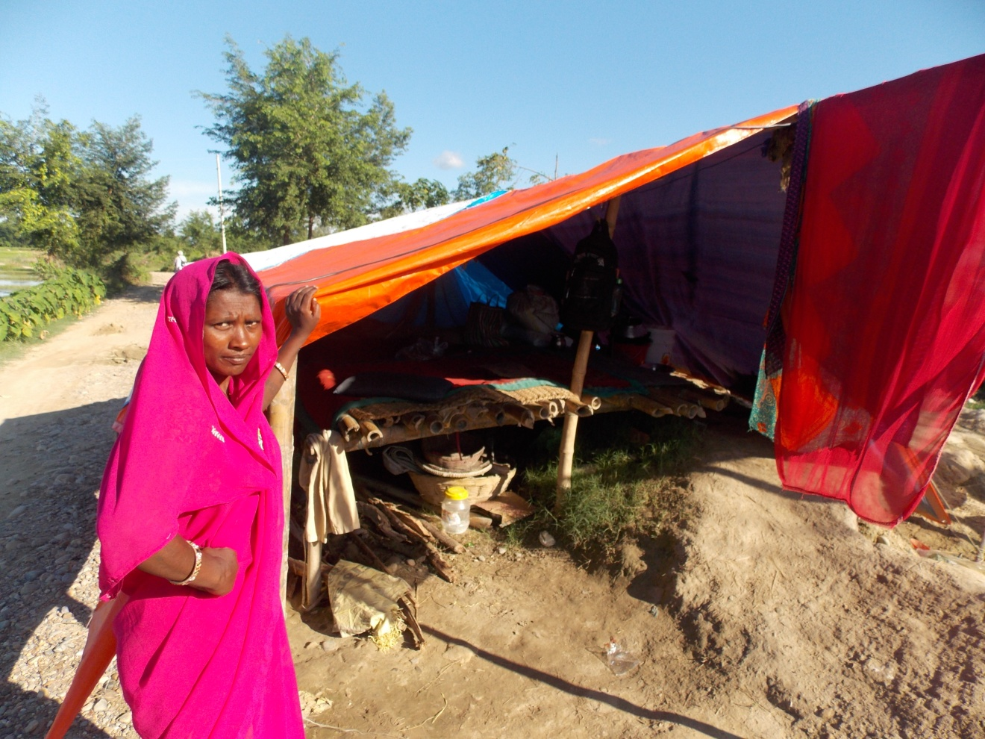
A widow
She has 4 children. She is worried about the shelter.

Slide 13
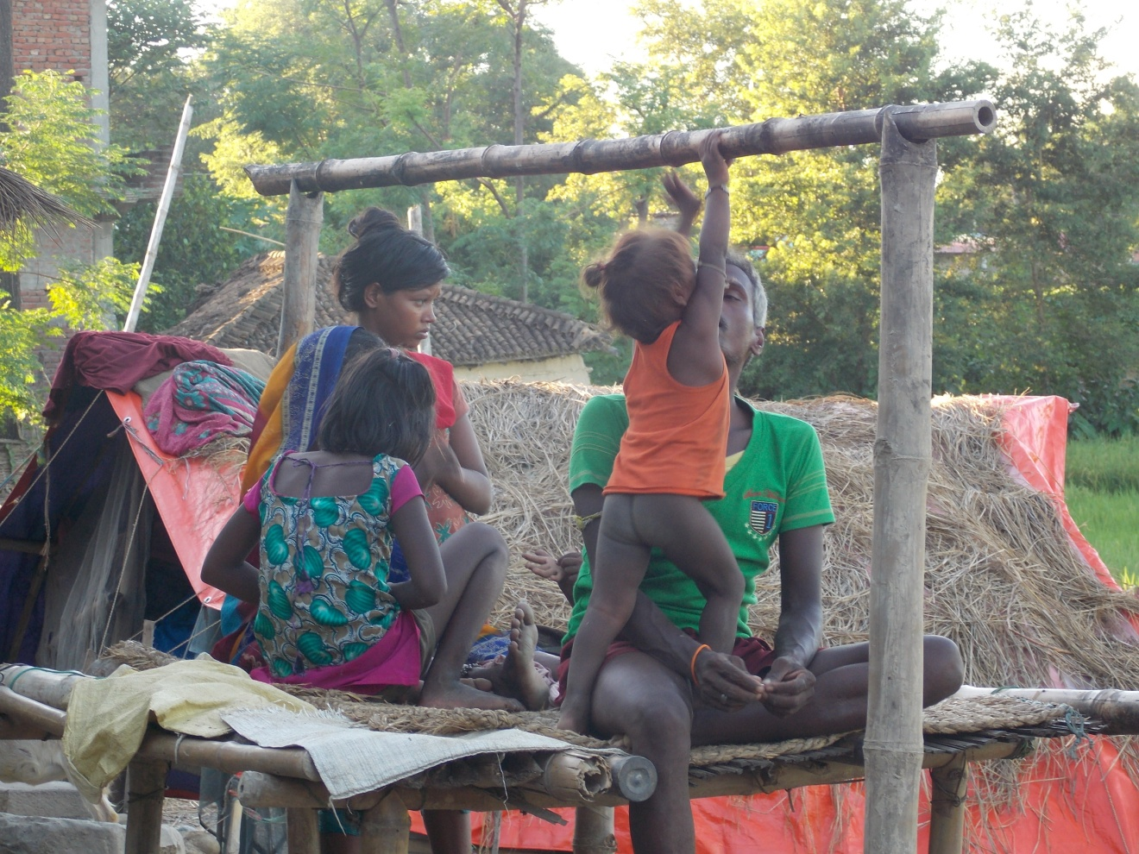
Picture speaks
They are worried how their children will stay in the winter without home

Slide 14
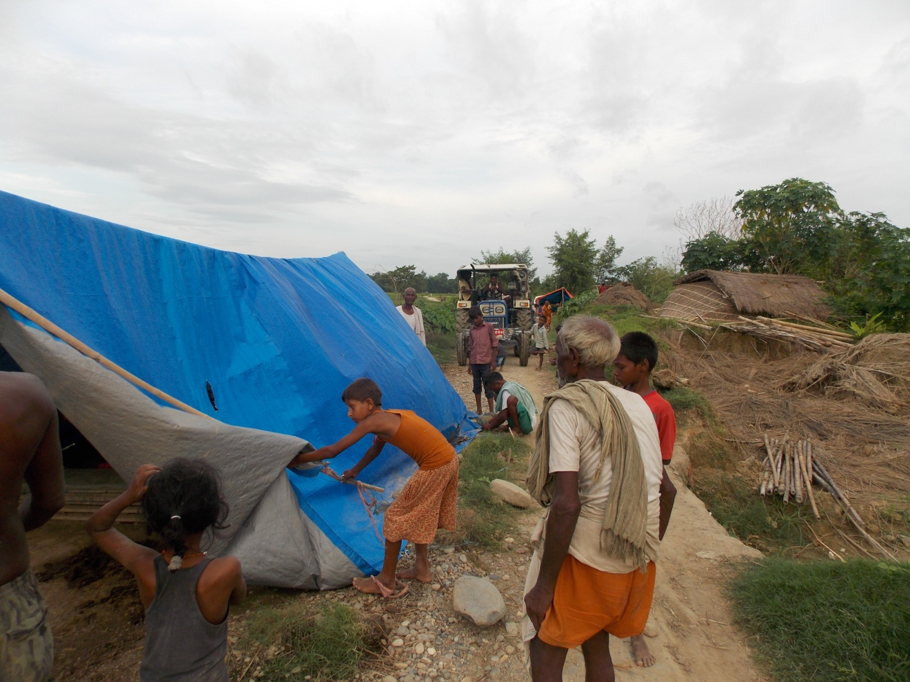
Materials arriving
There is not enough space for four wheelers . Clearing the road.

Slide 15
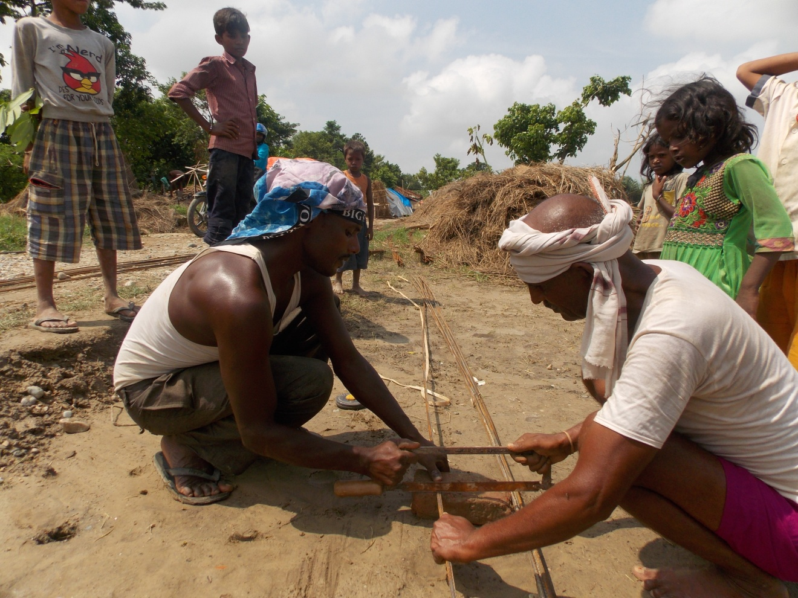
Iron rods
Starting the work

Slide 16
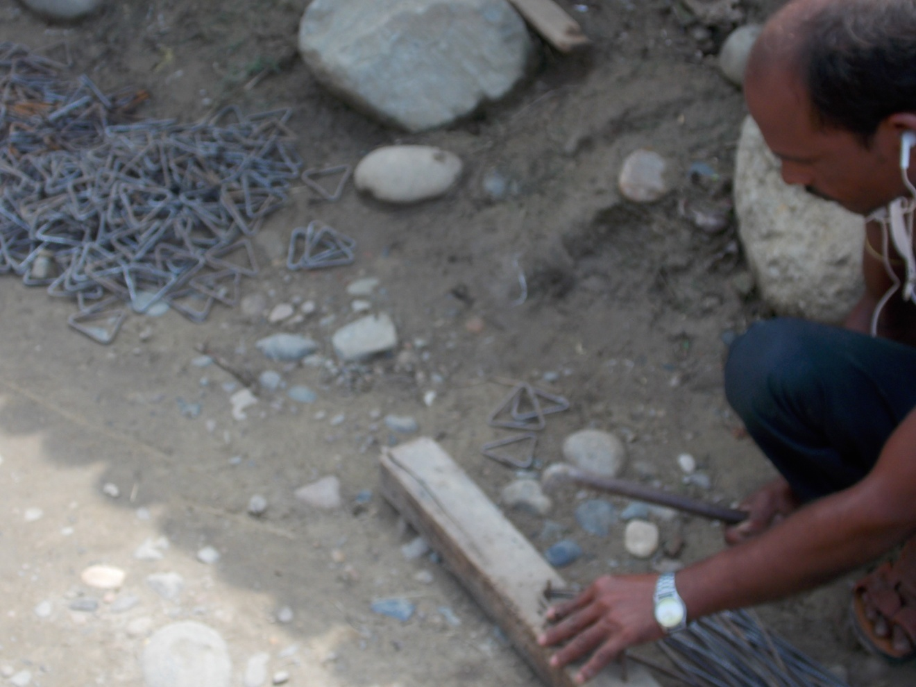
Preparing rims
All the pillars big or small will have these rims to make the pillar stronger

Slide 17
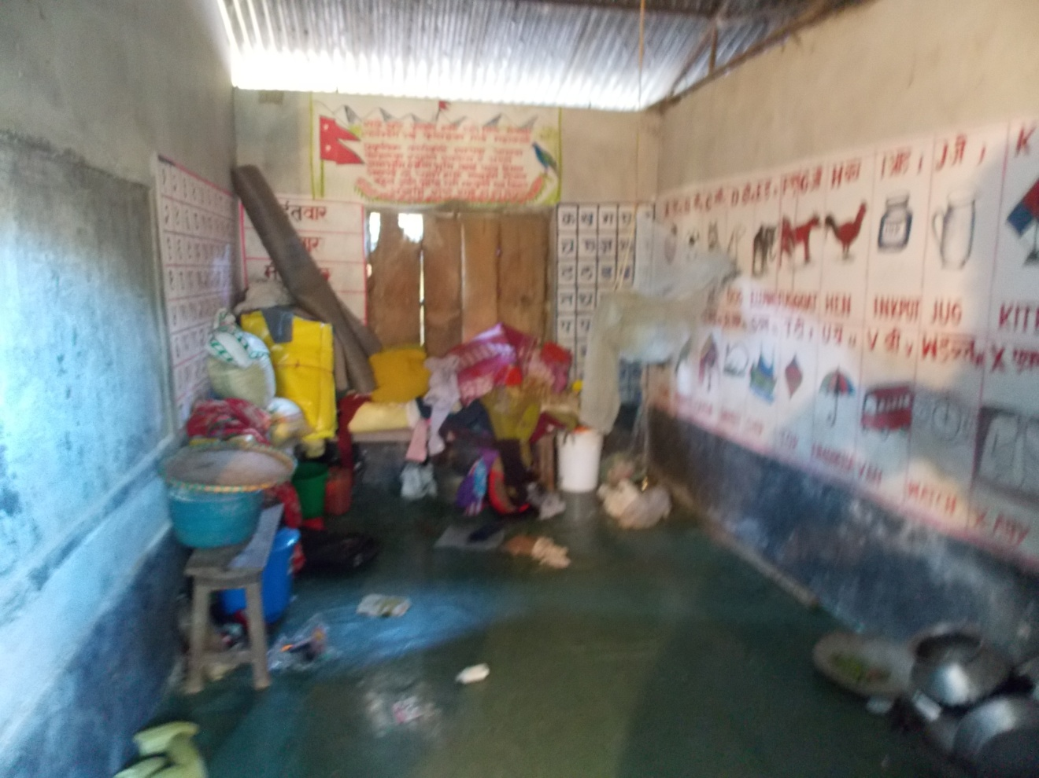
Family living in the School
These family is repetitively reminded by the school administration
To empty the room.

Slide 18
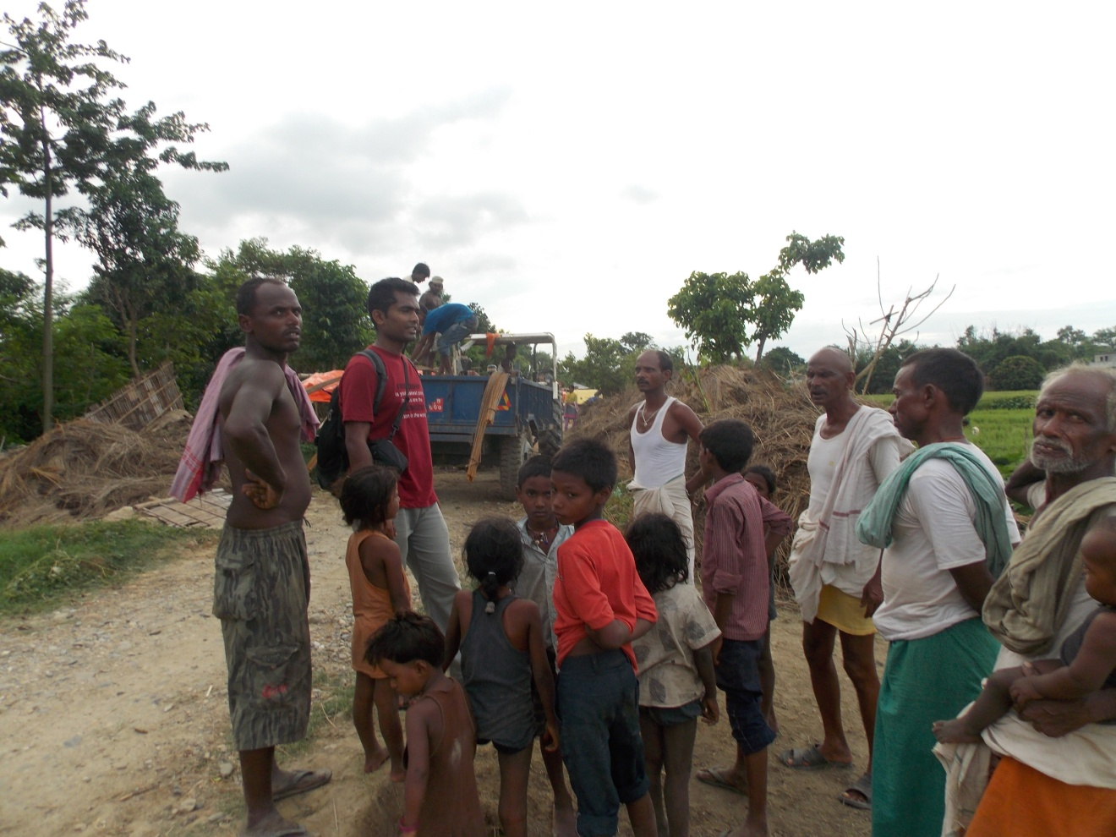
Talking to flood victims
Asking them to speed up the work

Slide 19
Post- flood construction work
THRD Alliance has decided to construct houses for the flood victim in Rautahat, Mahottari and Saptari.
In Rautahat the construction of the house started.
In Mahottari and Saptari the construction work is going to start shortly.

Slide 20
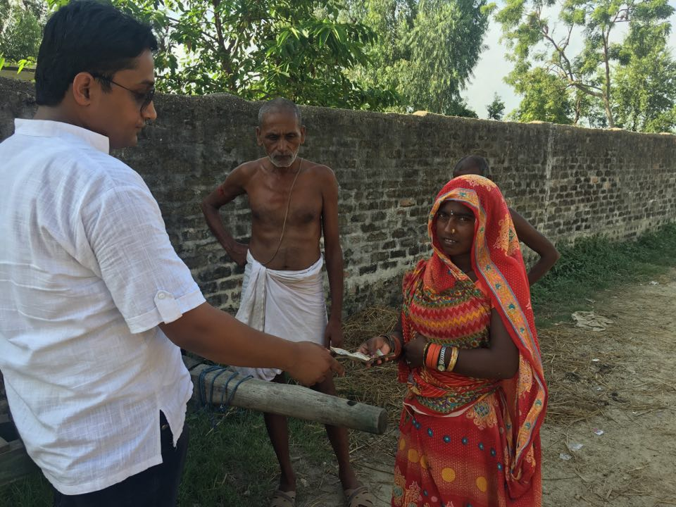
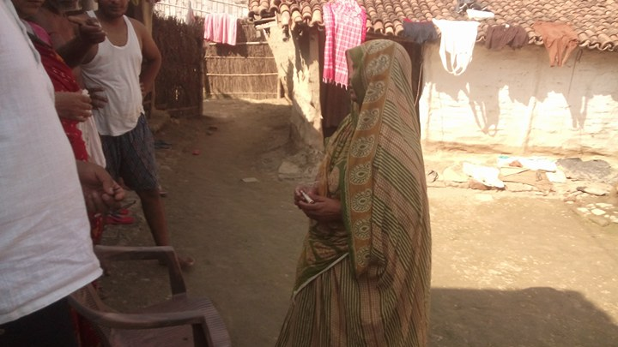
Advance issued for Mahottari housing project

